Slide 1
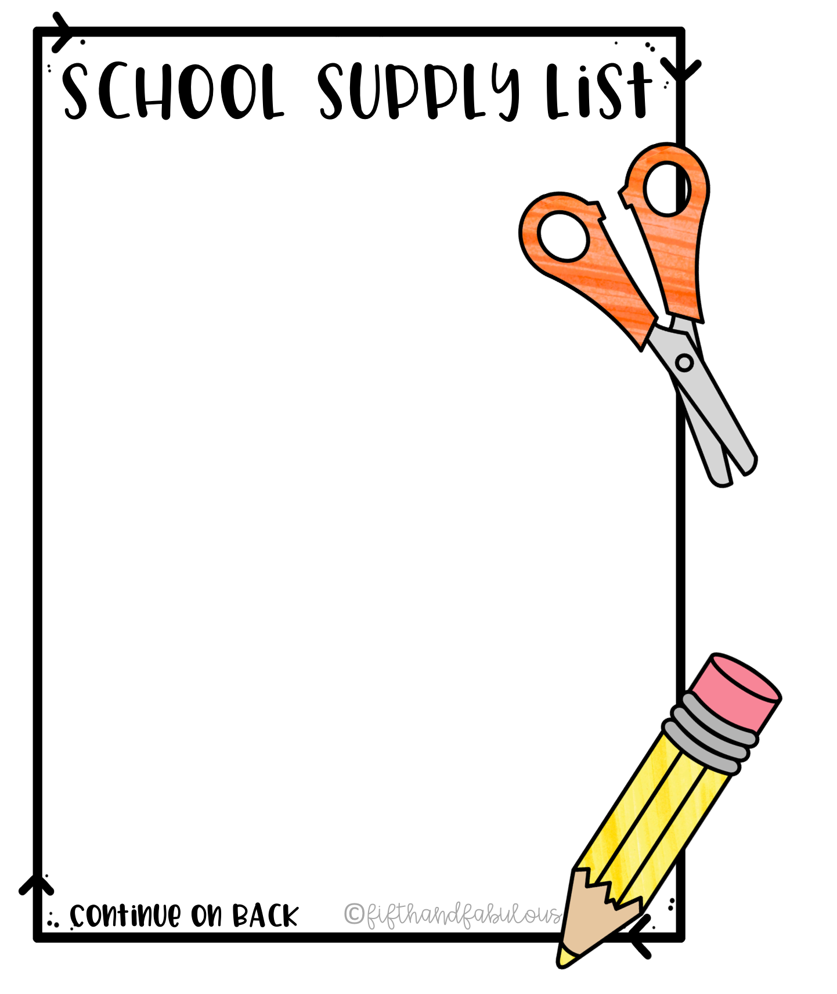
Rutledge Middle School
8th Grade
Pencils
Blue/Black Pens
Colored Pencils
Glue Sticks (Jumbo & Small Sizes)
4 Composition Notebooks
Scientific Calculator
College Ruled Loose Leaf Paper
Multi-colored Highlighters
2 Packs of Index Cards
( 500 Count; standard size)
4 3 Prong folders w/ pockets
1” inch Three Ring Binder
1 ½ Inch Three Ring Binder
2 Packs of Dividers
Pencil Pouch
2 Packs of Multi-Colored Post It Notes
Pocket Dictionary
1 Pack of Markers or Colored Sharpies
1 Fiskars Student Scissors
Earbuds
Homeroom Essential Supplies
Mesh or Clear Backpack
(No Roller Backpacks)
Hand Sanitizer
Disinfectant Spray
Kleenex (2 boxes)
Clorox Wipes
Paper Towels
Expo Markers (1 pack)
Copy Paper (1 pack)

